Slide 1


Simulations of geophysical fluids and planetary atmospheres
Brown Univ. – Kobe Univ. Joint Simulation Summer School
Aug. 31, 2015
Hirokazu Uede, Shu Ogawara, Will Wright, Zheng Sun,
and Yoshiyuki O. Takahashi

Slide 2
General introduction
In our group, members are working on simulations on phenomena in an idealized atmosphere and its simplified form, a shallow water system.
Atmosphere and shallow water system show many kinds of phenomena. In our project, we are focusing on following two topics:
  advection of materials,
    Shu and Zheng
  atmospheric waves.
    Hirokazu and Will

Slide 3
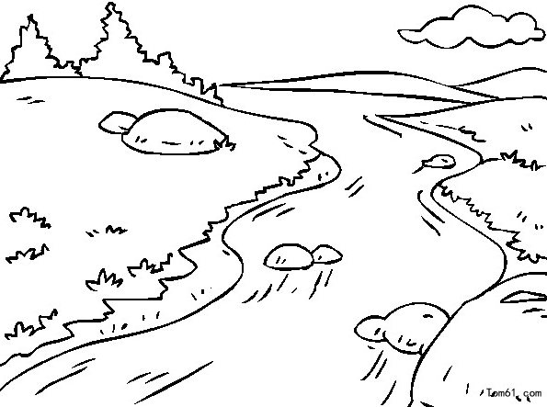
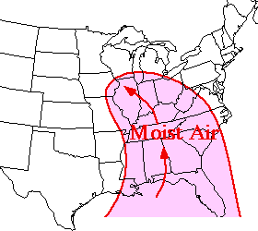
Advection
Definition
Advection is a transport mechanism caused by fluid’s bulk motion.
Examples
  Movement of silt in a river by bulk water flow downstream.
  Transportation of moist air mass by the winds.
Remarks
Not only materials, but also energy and enthalpy are transported via advection.

Slide 4

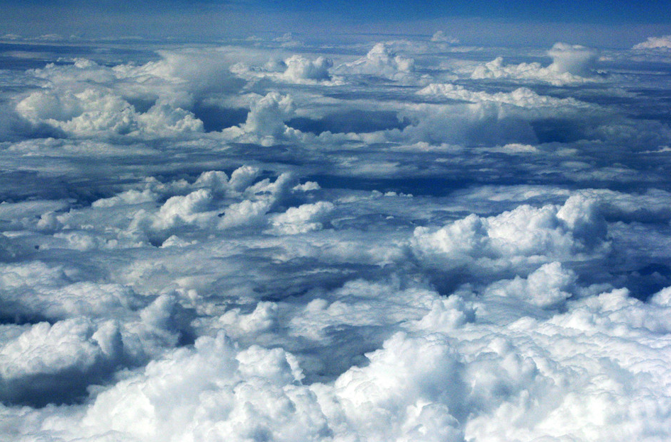
Advection of Clouds
We focus on simulating cloud movement under advection.
Shu works on tracking a single small batch of clouds in Lagrangian coordinates.
Zheng simulates the transport and shape changes for a huge group of clouds in Euler coordinates.

Slide 5
Simulation of a Single Cloud
I simulated how a single cloud moves in winds.
  - A single cloud … its mass and size can be ignored.
  - Using “Lagrangian coordinates”.
The velocity vector of such a cloud COINSIDES with that of winds
I use Forward Difference Method for digitizing

Slide 6
DCPAM (Dennou-Club Planetary Atmospheric Model)
The numerical model for computing an atmospheric circulation on a sphere
Fortran codes to solve primitive equations are provided by using this model
  Primitive equations are used widely for weather forecast
  By using codes, we can simulate a circulation easily
  The visualization of results can also be obtained easily
Dennou is a Japanese literary word, which stands for a computer
  Dennou-club is a group of Japanese scientists interested in planetary hydrodynamics

Slide 7
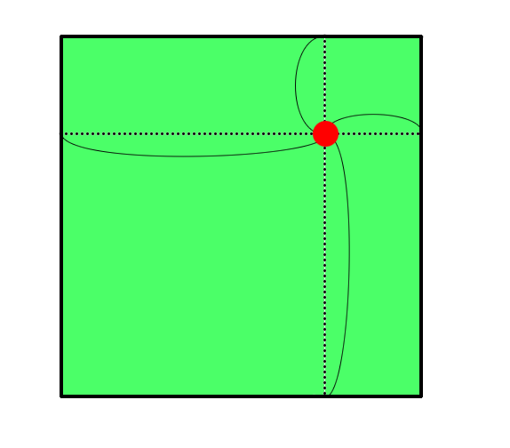
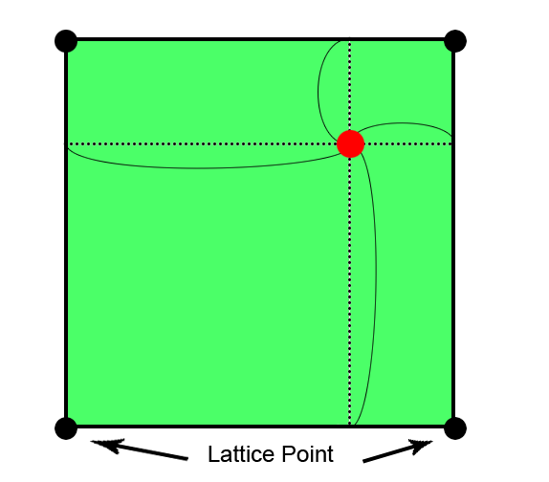
Computing the wind-velocity correctly
In DCPAM, the wind velocity is computed only on specific lattice points
To compute the wind velocity more accurately, I used weighting coefficients as below:
( i, j+1 )
( i+1, j+1 )
t
The wind velocity on the red point:
s
v( i, j ) * s t +
v( i+1, j ) * (1-s) t +
v( i, j+1 ) * s (1-t) +
v( i+1, j+1 ) * (1-s)(1-t)
1-s
1-t
( i, j )
( i+1, j )

Slide 8
Simulations
Let’s Watch a 3D Video !

Slide 9
Model for a Group of Clouds
Difficulty
Tracking each small cloud calls for huge amount of works.
Model
We treat the cloud as a mixture of tiny water drops and the air. We could determine the shape and the thickness of the clouds if we know the mass ratio of the water drops.
Equation

Slide 10
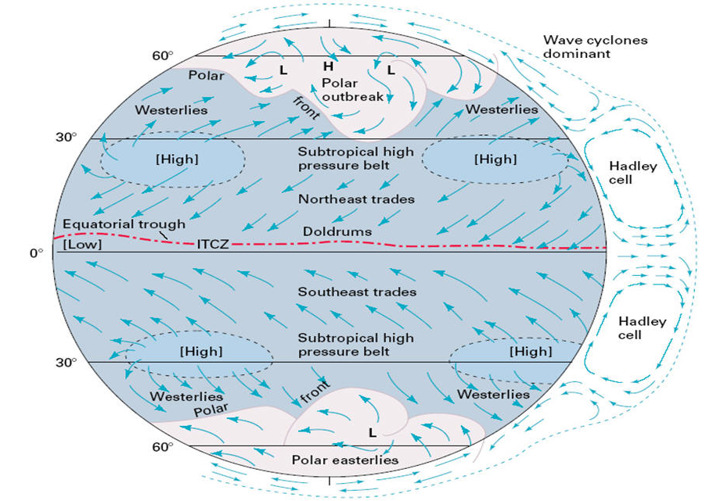
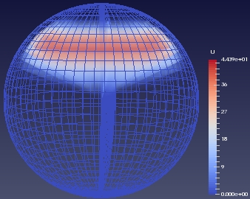
Winds and Areas of Interest
Area: We focus on the winds in the middle latitudes.
Winds: We use the DCPAM to calculate the wind velocity in this area. There is only east wind at the very beginning.

Slide 11
Numerical Methods
Scheme
Freeze wind velocity in each step.
Use leap-frog method to solve the equation.
Boundary Conditions
Periodic b.c. for longitude:
Zero Neumann b.c. for other directions:

Slide 12
Simulations
Let’s Watch a 3D Video !

Slide 13
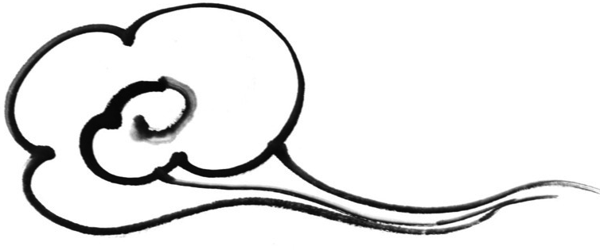
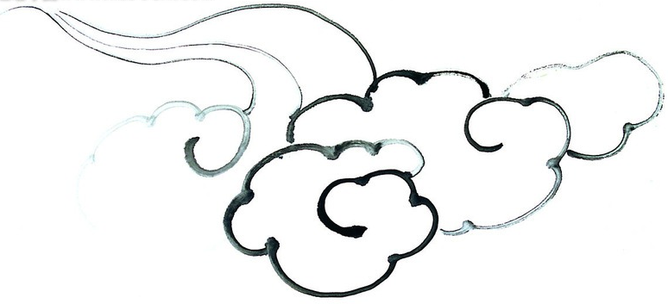
Summary of Our Part
We are simulating the same object with different scales and different view points.
Lagrangian coordinates can be used to track the movement of a single object, while Euler coordinates are suitable for describing the material distribution.

Slide 14
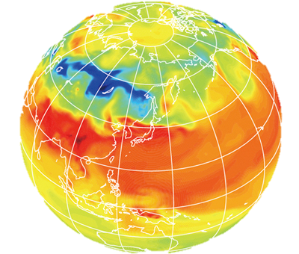
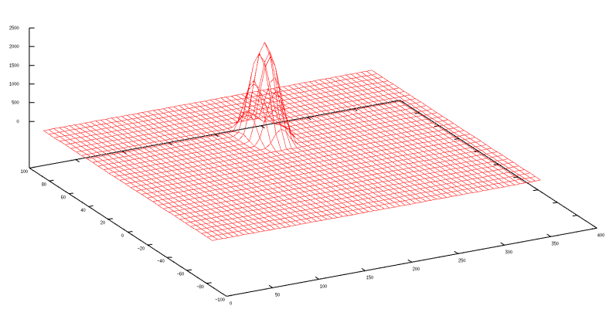

Atmospheric Waves Simulation
The aim
To see how do atmosphere waves going on
after they hit a mountain or the real geography
Solve the fluid dynamic with “DCPAM” or “Shallow Water Model”
Compare and Consider in 2D or 3D
Notes:
大きな目標「大気シミュレーション」
その中で我々のパートでは，何もない状態での大気の流れと，山実際の地形を置いた時の大気の流れをシミュレートした．
目標としてはそれを可視化することである．
自分のやったこと
1つ山を作り，その地形をモデルに組み込むことにより，大気の流れを見る．（DCPAMで）
ウィルのやったこと
1つ山を作り，その地形をモデルに組み込むことにより，大気の流れをみる．（Shallow Water Modelで）
ウィルはさらに実際の地形でのシミュレートをし，
自分は3Dでの可視化を試みた．

Slide 15
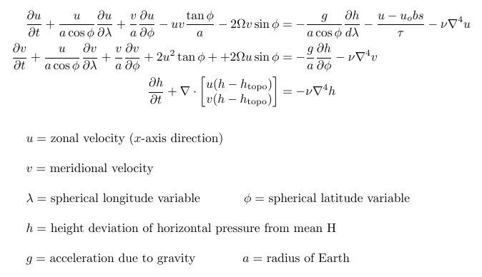
Shallow Water Equations

Slide 16
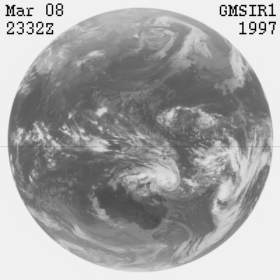
Setup and Initial Conditions
Shallow water topography
  Mesh of Earth terrain
  Flat mesh with single mountain
Both begin with higher pressure at the equator and lower pressure at poles
Zonal velocity equation has wind forcing term to model northern hemisphere flow

Slide 17
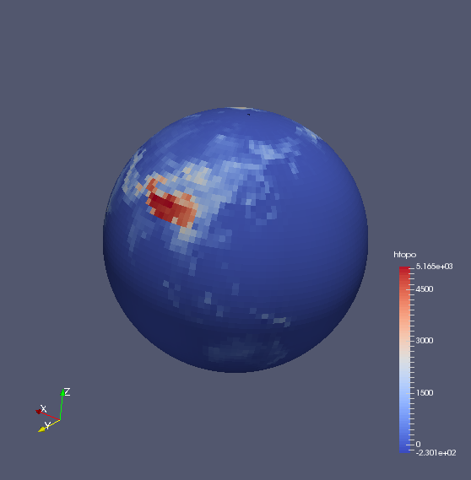
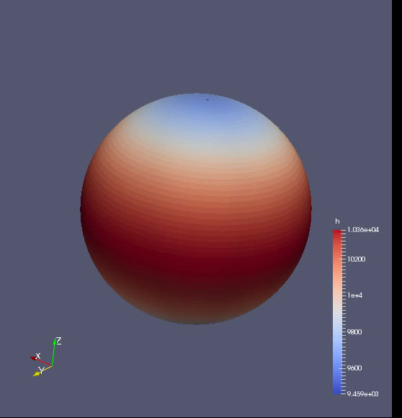
Pressure Level in Shallow Water Simulation
Northern Hemisphere over Two Months
To use

Slide 18
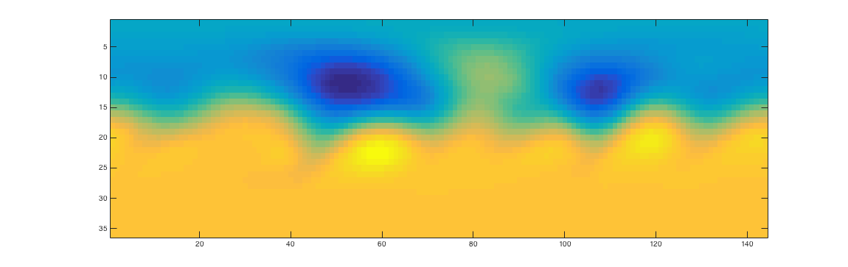
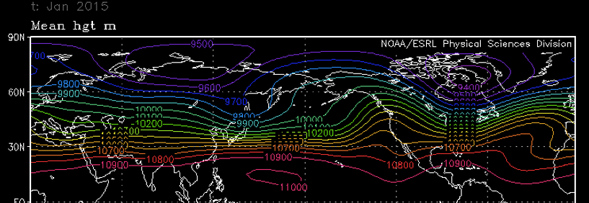
Time Averaged Simulation vs
Actual Results over January 2015
Notes:
Why do I choose this theme?, because My study is similar to this theme.
My study is wind power assessment to calculate the wind for wind power electric generation,
In this time, I simulate how atmosphere going on or spread after it hit a mountain, by using atmospheric model; DCPAM.

Slide 19

Shape of Mountain
How to make
To use “Gnuplot”, we drew a mountain which has 2500m height.
Notes:
高さ2500ｍの山の地形を作成し，モデルに組み込むことにより，大気が山に当たった時の効果を確認する．

Slide 20
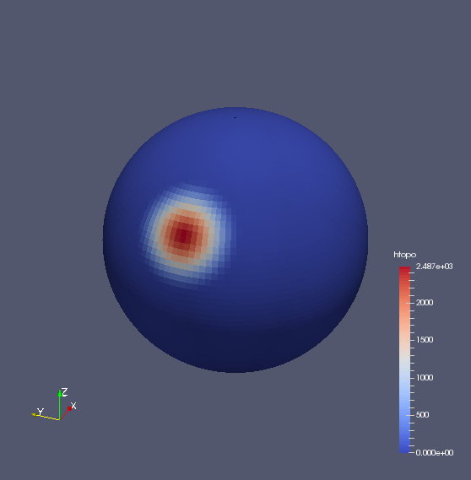
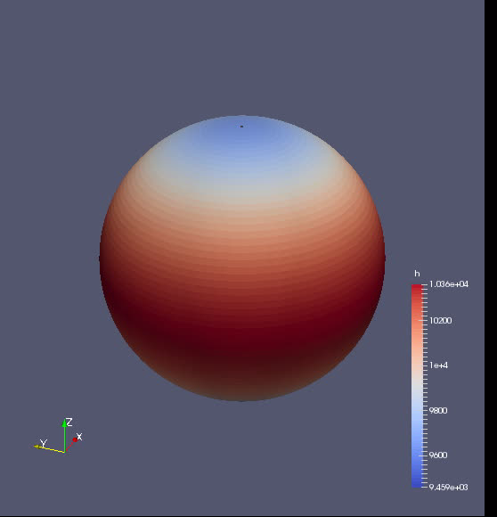
2D Simulation

Slide 21
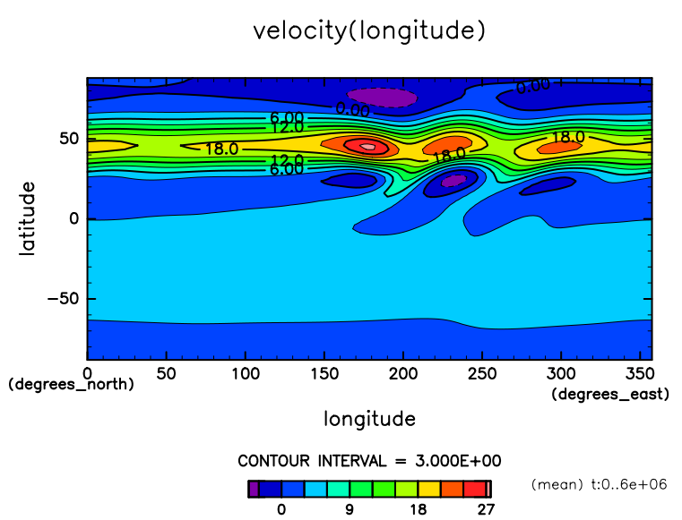
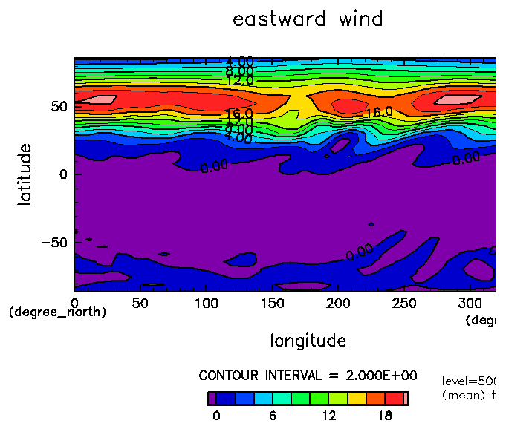
Comparing 2D to 3D Results
Shallow Water Model
DCPAM
Notes:
これは各モデルにおける2次元での比較である．
DCPAMは3次元モデルであるが，ここでは500hPa面での風速を取り出している．
shallowモデルはほぼ2次元のモデルとみなす．
3次元のモデルであるDCPAMの方が再現性が高いが，
shallowモデルでも最大値の位置の違いなどは生じているが，だいたい同じような風速の分布図が出来ていることがわかる．

Slide 22
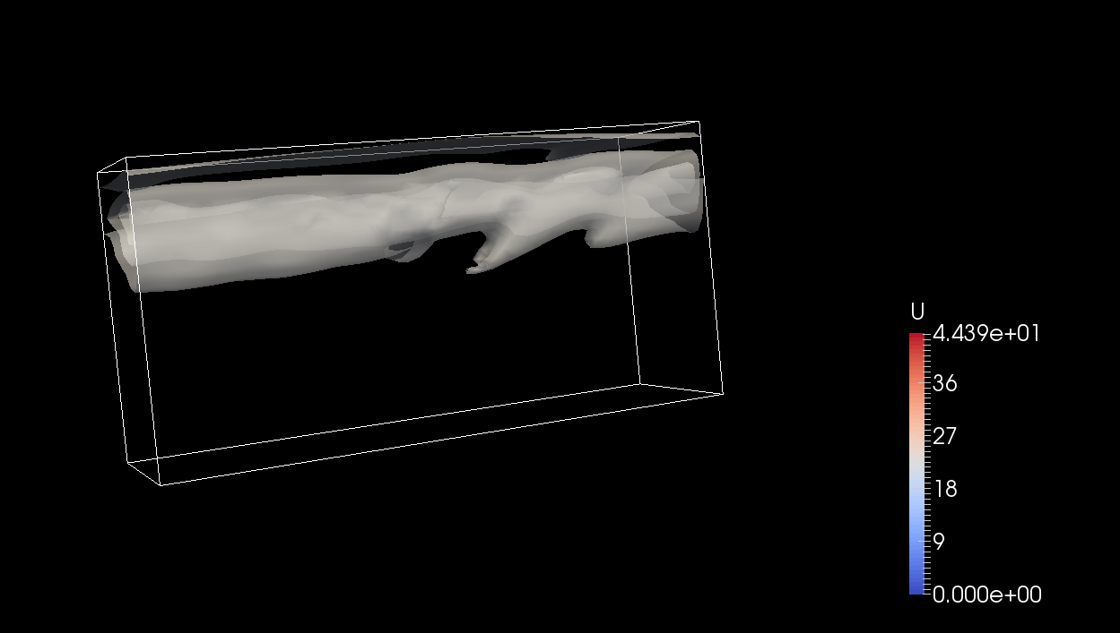
3D Visualizing
How to make
To use “paraview” which is software of visualize
We tried to visualize “wind velocity”

Slide 23
3D Visualizing
Let’s Watch 3D Videos !

Slide 24
Summary of our part
The shallow water simulation is a decent model for large pressure trends over longer intervals
The Shallow Water Model results closely resemble those of the DCPAM
We could see the atmosphere flows more clearly in 3D simulation

Slide 25
Summary of our project
We worked on simulations of advection of a material and atmospheric waves. All members made codes from scratch or modify pre-existing codes, and perform simulations.
Simulations of advection show fluctuations caused by atmospheric mean flow and waves. And, simulations with Eulerian and Lagrangian frameworks can give some insights into material movement in different points of view.
Simulations of waves in 2D and 3D systems show atmospheric response by geography (idealized and realistic). And, a result of 3D system can be interpreted by that of 2D system in some senses.

Slide 26
Thank you.

