Slide 1
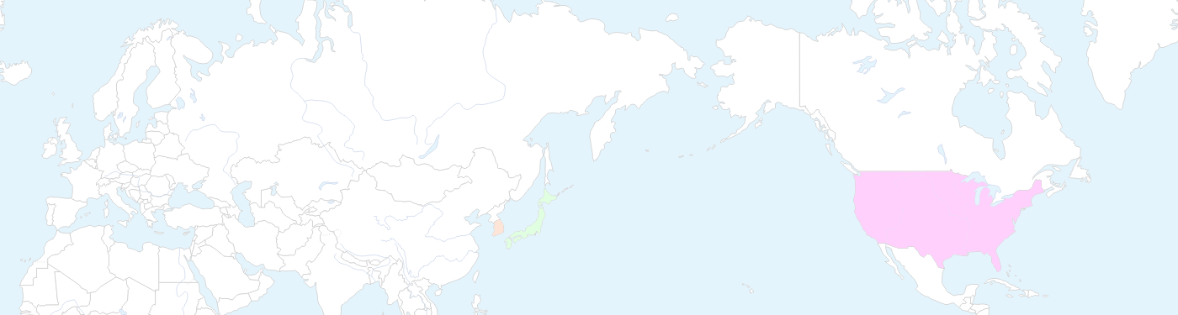
Kobe-Brown Simulation Summer School 2015
Project: DPD Simulation of a Membrane
Clark Bowman
Karen Larson
Yuji Funaki
Ross Parker
Tae Woo Kim

Slide 2
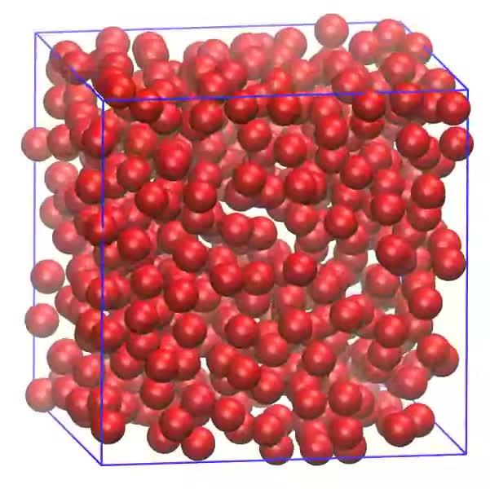
Week 1: Introduction to Molecular Dynamics (MD)
Computer simulation of a large number of particles
Trajectories of particles are determined
by solving Newton’s laws numerically
Simulation proceeds in discrete time steps

Slide 3
Goal of Week 1
Write a two-dimensional MD simulation of liquid argon from scratch using C++!
Forces calculated using Lennard-Jones (LJ) potential
Velocity Verlet method used for numerical integration
Experiment with different boundary conditions (periodic, reflecting, no-slip)

Slide 4
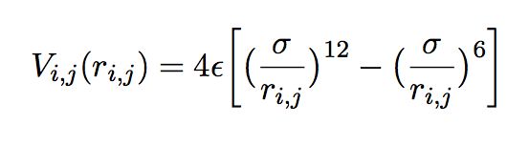
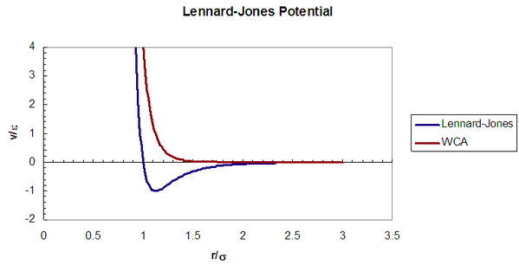
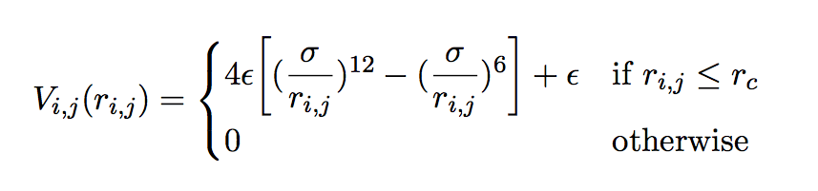

Lennard-Jones Potential
Lennard-Jones Potential
Image: http://s110.photobucket.com/user/ecfreema/media/LennardWCAPlot.gif.html

Slide 5
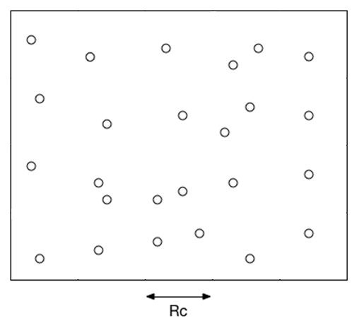
Force Calculation: Pairwise Forces

Slide 6
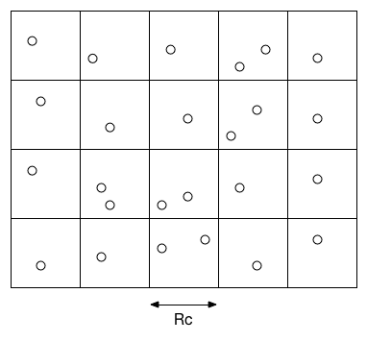
Force Calculation: Cell List Method

Slide 7
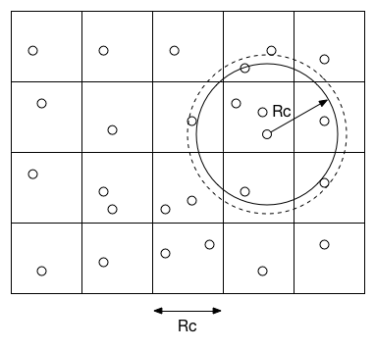
Force Calculation: Neighbor List Method

Slide 8
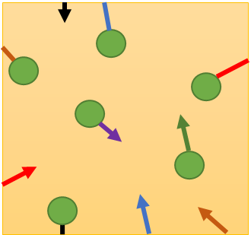
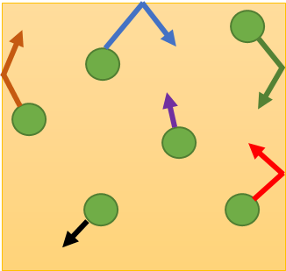
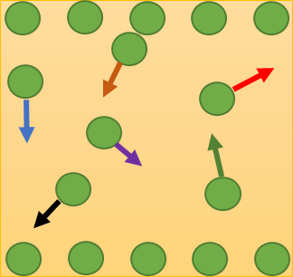
Boundary Conditions
Periodic
Reflecting
No-slip

Slide 9

Testing the Code: Flow in a Pipe
3D rectangular channel with no-slip walls
Channel filled with LJ fluid
Uniform force along channel due to
pressure gradient (Poiseuille flow)
→ Parabolic velocity profile?

Slide 10
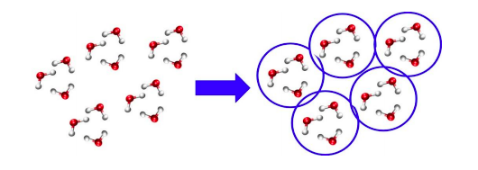
Week 2: Dissipative Particle Dynamics (DPD)
Particle simulator like Molecular Dynamics
Coarse-graining: model groups of atoms as single “beads”
Reduced complexity allows simulating larger systems while still modeling flows
Image: http://arxiv.org/pdf/1506.06202.pdf

Slide 11
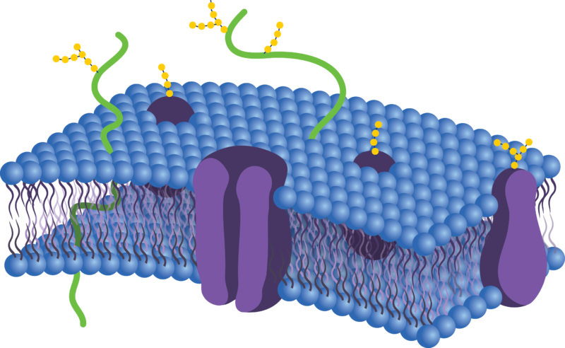
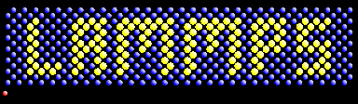
Goal of Week 2
Simulate a 3D bilipid membrane with DPD and study its properties!
Method: LAMMPS particle simulator
→ same algorithms as Week 1, but parallel/optimized
Means: Brown CCV Computing Cluster “Oscar”
→ 657.8 Teraflops across 7,632 Intel Xeon E5 cores
Images: http://www.ck12.org/biology/Phospholipid-Bilayers/lesson/Phospholipid-Bilayers, lammps.sandia.gov

Slide 12
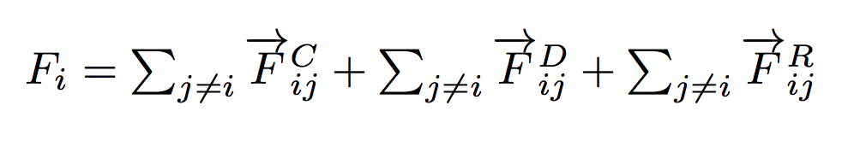
DPD Force Equation
In MD, only force was due to LJ pairwise interactions
DPD has three forces:
Conservative force (soft repulsion), Dissipative force (viscous resistance), Random force (thermostat)
New forces compensate for coarse-graining to yield similar mechanics

Slide 13
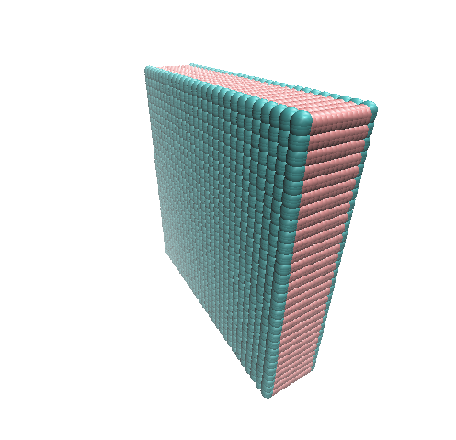
Creating a DPD Bilipid Membrane
Built out of lipids:
Blue = hydrophilic head particles
Red = hydrophobic tail particles
Harmonic (spring) bonds
Initialize on cubic lattice

Slide 14


Tunable Parameters to Achieve Stability
Structure of lipids (e.g., number of tail beads)
Dimensions of lattice for initialization (e.g., space between lipids)
Spacing between two halves of membrane
Conservative coefficient and dissipative coefficient for different types of beads (water, heads, tails)

Slide 15
Exploring DPD Parameters
For water, = 25.0 and = 4.5 (Groot, Warren 1997)
For lipid heads and tails: ???

Slide 16
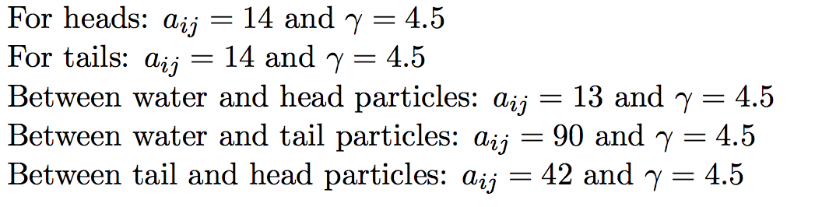
Exploring DPD Parameters (End Result)

Slide 17
Simulation 1: Pinned Membrane
Pin (fix in place) corners of membrane
Subject membrane to uniform orthogonal force
→ What shape is formed?
Record extent of deflection for different forces
→ At what force does the membrane break?

Slide 18
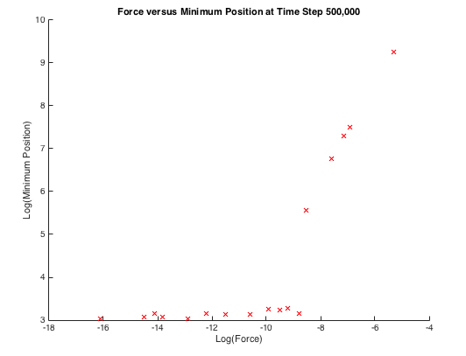
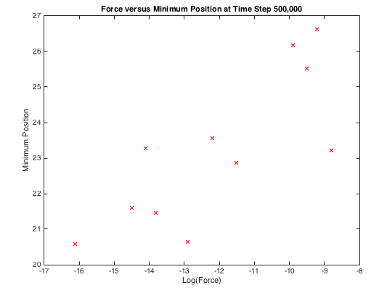
Forces and Membrane Breaking

Slide 19
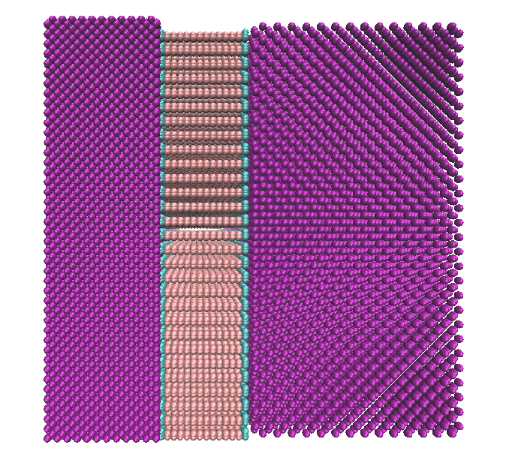
Simulation 2: Density Difference
Numerical density:
10.0
Numerical density:
3.0
Increase fluid density on one side of membrane
Reflecting walls keep sides separate
→ How does the membrane move?

Slide 20
Final Distance Traveled by Membrane

Slide 21
Membrane Position Over Time

Slide 22
Project Recap
Week 1
MD implemented from scratch in C++
Simulation: Flow in a Pipe
Week 2
DPD model of a membrane in LAMMPS (project goal)
Simulation: Pinned Membrane
Simulation: Density Difference

Slide 23
Thank you for your attention!

